Slide 1
Planning a travel journey
Abdelrahman Khaled Mansour.

Slide 2

Agenda
Introduction
Diagram
Code
Trace

Slide 3
Introduction
This Prolog code is designed to assist in planning travel journeys from one place to another in Egypt, considering various transportation modes. The code defines places, transportation modes, and connections between places with available modes of transportation. It also includes rules for determining valid travel journeys and extracting the intermediate places in the journey.
Facts:
Places in Egypt: The code lists sixteen places in Egypt, such as Cairo, Mansoura, Luxor, Aswan, etc.
Transportation Modes: Three transportation modes are defined: car, train, and plane.
Connections between Places: The code specifies connections between places along with the available transportation modes for each connection.

Slide 4
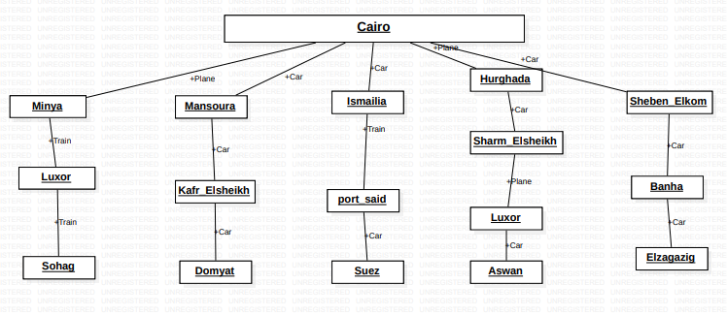
Diagrams

Slide 5
Code
Places.
01
Transportation Modes.
02
Connections.
03
Rules
04
Valid Journey.
05
Invalid Journey.
06

Slide 6
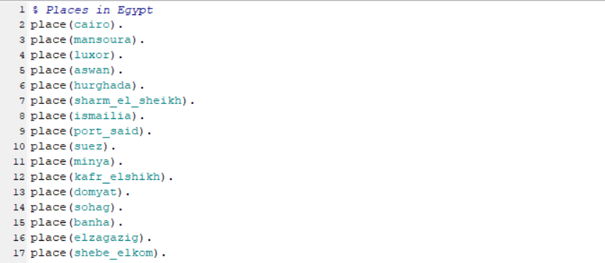
Places

Slide 7

Transportation modes

Slide 8
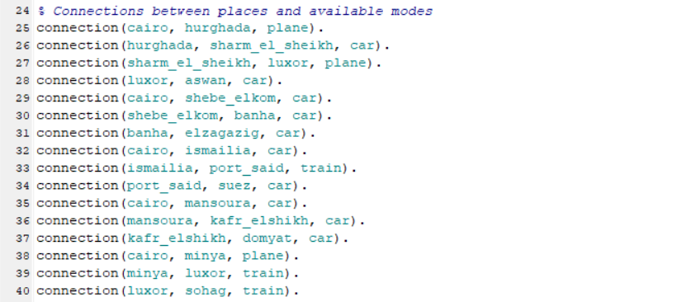
Connections

Slide 9
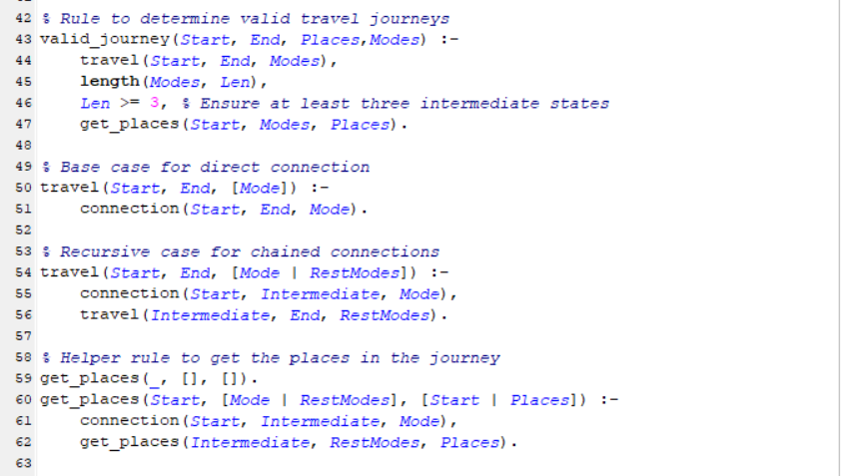
Rules
Valid Journey Rule :
This rule is used to determine if a valid travel journey exists between two places.
It ensures that the journey passes through at least three intermediate states.
The journey details, including intermediate places and transportation modes, are retrieved.
Base Case for Direct Connection :
This rule handles the base case when there is a direct connection between two places using a specific mode of transportation.
Recursive Case for Chained Connections :
This rule represents the recursive case when a journey involves chaining together multiple connections.
It recursively explores connections between intermediate places until the destination is reached.
Helper Rule to Get Places in the Journey :
This rule is a helper rule used to extract the intermediate places in a journey.
It recursively traverses the journey and accumulates the places visited.

Slide 10
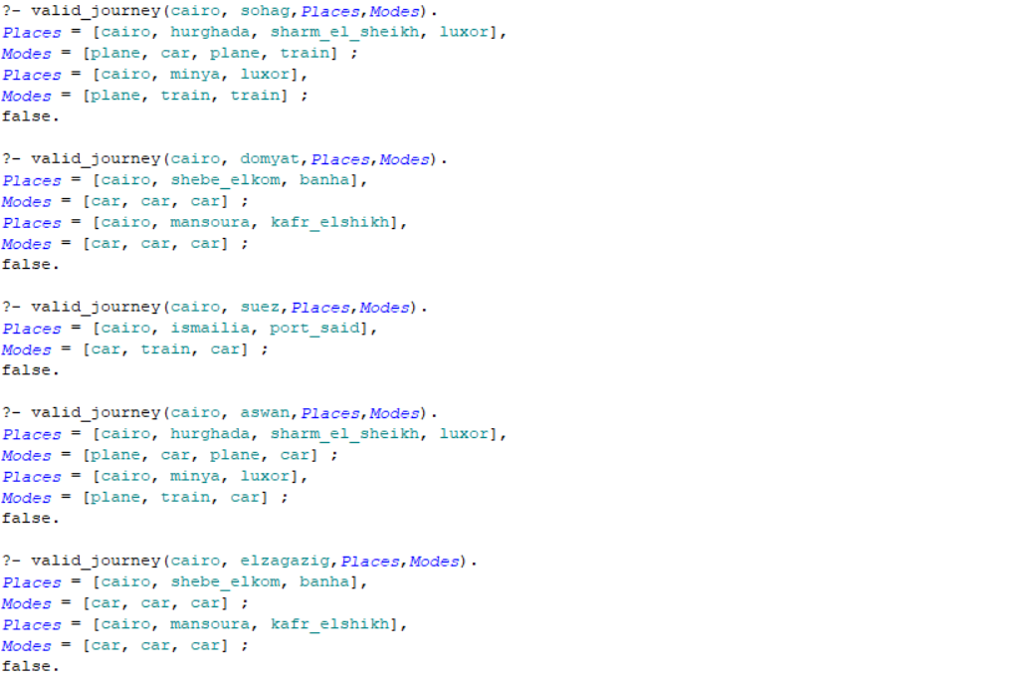
Valid Travel

Slide 11
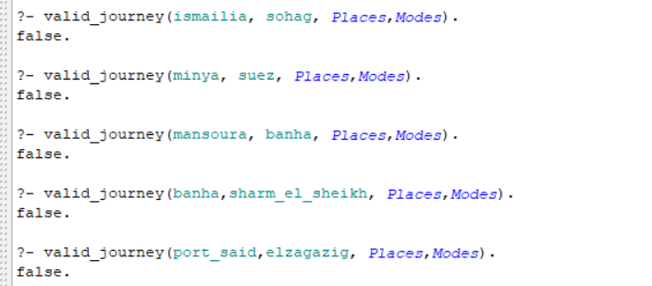
Invalid Travel

Slide 12
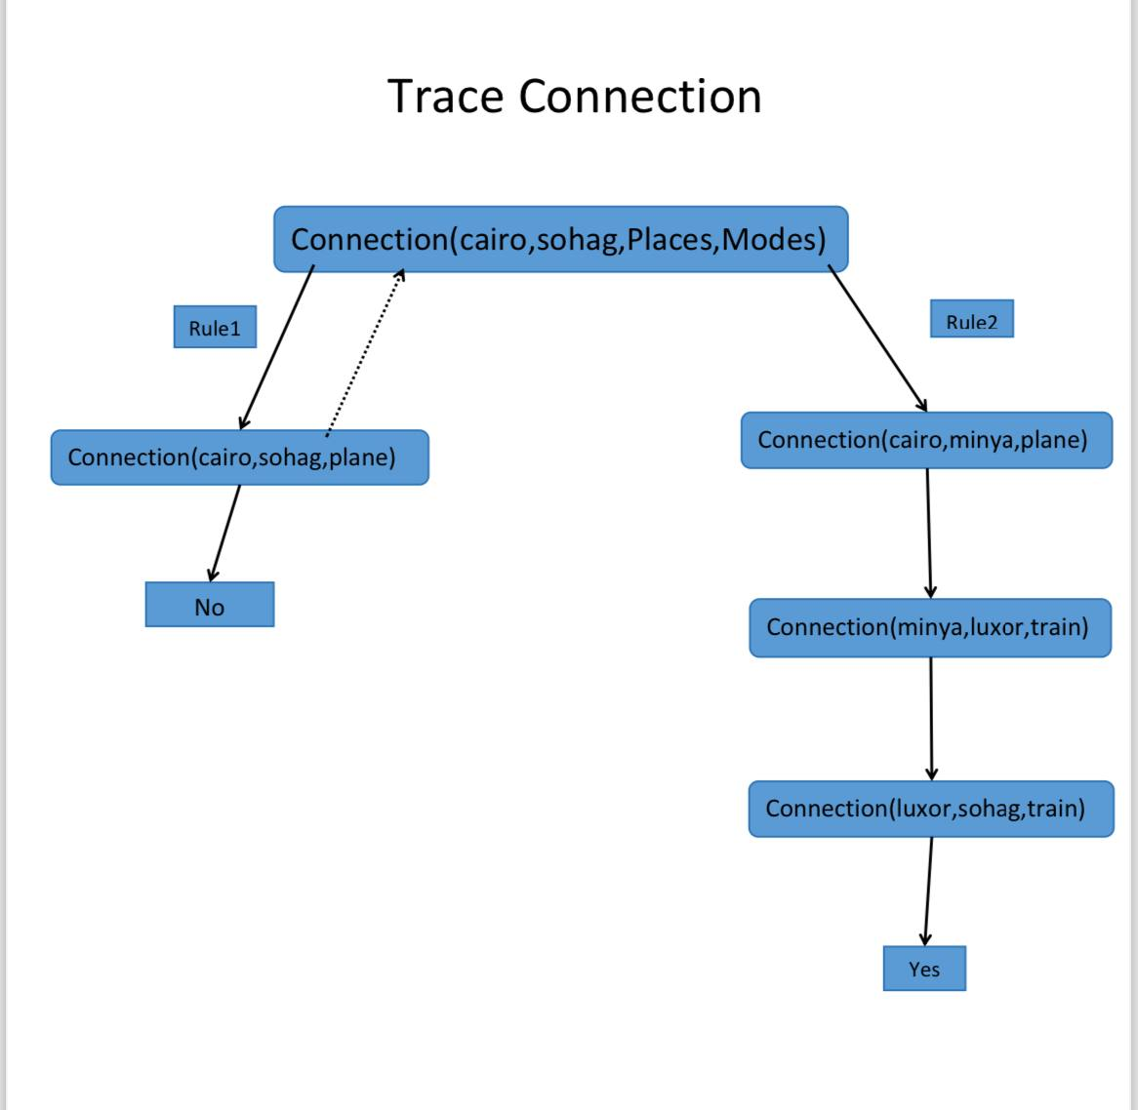
Trace

Slide 13
Thank you

